Slide 1


K.RAMAKRISHNAN COLLEGE OF TECHNOLOGY (AUTONOMOUS), TRICHY
CREATING PIE CHARTS AND HISTOGRAMS
FOR SURVEY DATA
PRESENTED BY
ABINESH R - ADA23007

Slide 2
PRESENTATION OVERVIEW
PROBLEM IDENTIFICATION
OBJECTIVE
ARCHITECHTURE DIAGRAM
PROPOSED SYSTEM
ADVANTAGES OF PROPOSED SYSTEM
LIST OF MODULES
MODULE DESCRIPTION
SCREENSHOTS
CONCLUSION AND FUTURE ENHANCEMENT

Slide 3
PROBLEM IDENTIFICATION
Issue:
Manual survey data analysis is time-consuming and lacks interactivity.
Need:
An automated, interactive tool for quick insights from survey data.
Challenge:
Effectively visualizing categorical (e.g., Gender) and numerical (e.g., Age) data for actionable insights.

Slide 4
OBJECTIVE
This project aims to develop an R Shiny web app to automate survey data analysis, enabling small businesses to gain quick insights. It focuses on creating interactive pie charts for categorical data (e.g., Gender) and histograms for numerical data (e.g., Age), with real-time filtering, statistical analysis, and export options to support data-driven decisions in marketing.
Key Objectives:
Pie Charts for Categorical Data: Show proportions of survey responses.
Histograms for Numerical Data: Analyze data distribution and trends.

Slide 5
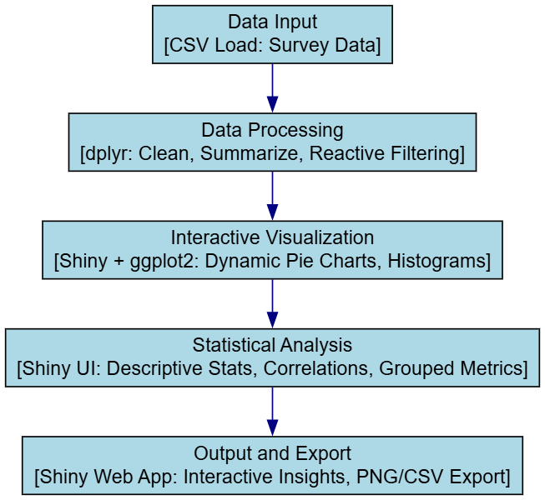
ARCHITECHTURE DIAGRAM

Slide 6
PROPOSED SYSTEM
Platform: R Shiny web application with ggplot2, dplyr, scales, and DT.
Key Components:
Data Input: Upload CSV files or use sample survey data.
Processing: Clean and filter data reactively.
Visualization: Generate dynamic pie charts and histograms.
Analysis: Display statistics and correlations in the UI.
Export: Save charts (PNG) and data (CSV).
Outcome:
Interactive, real-time survey analysis for small businesses and researchers.

Slide 7
ADVANTAGES OF PROPOSED SYSTEM
Interactive & Dynamic: Real-time filtering and visualization with Shiny.
Comprehensive Insights: Visuals plus statistical analysis (e.g., correlations).
Time-Saving: Automates chart creation and data processing.
User-Friendly: Intuitive UI for non-coders to explore survey data.
Exportable Outputs: Charts and data downloadable for reports.

Slide 8
LIST OF MODULES
Data Processing Module: Load, clean, and filter survey data.
Visualization Module: Create pie charts and histograms.
Statistical Analysis Module: Compute and display stats.
Export Module: Save visualizations and data files.

Slide 9
MODULE DESCRIPTIONS
1. Data Processing Module:
Loads CSV files or sample data (e.g., read.csv()).
Cleans data (e.g., na.omit() with dplyr).
Applies reactive filters (e.g., Age range).
2. Visualization Module:
Generates pie charts for categorical data (e.g., Gender).
Creates histograms for numerical data (e.g., Age).
Uses ggplot2 with Shiny for interactivity.

Slide 10
MODULE DESCRIPTIONS
3. Statistical Analysis Module:
Computes descriptive statistics (e.g., mean, median).
Calculates correlations (e.g., Age vs. Satisfaction).
Displays results in Shiny UI tables.
4. Export Module:
Downloads pie charts/histograms as PNG (ggsave()).
Exports filtered data and stats as CSV.

Slide 11
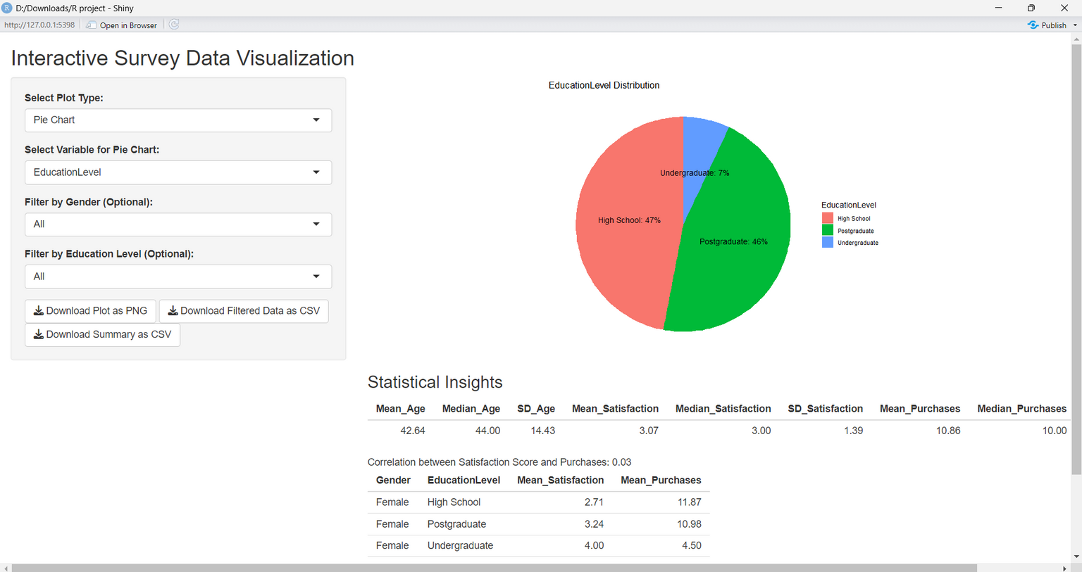
SCREENSHOT

Slide 12
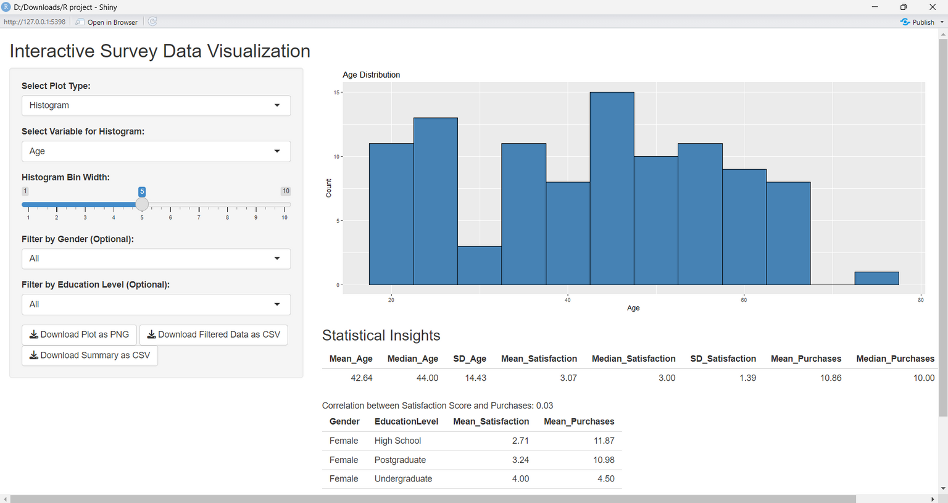
SCREENSHOT

Slide 13
CONCLUSION
The R Shiny app successfully automates survey data visualization, delivering interactive pie charts, histograms, and statistical insights. It streamlines analysis for small businesses, saving time and enhancing decision-making with exportable outputs for reports.
Future Enhancements
Add real-time API integration (e.g., Google Sheets).
Incorporate advanced analytics (e.g., sentiment analysis).

Slide 14
THANK YOU

